Slide 1

ARRA Reporting System
September 17, 2009

Slide 2

2

Slide 3
What is Different About ARRA Funds?
  Unprecedented levels of transparency, oversight and
  accountability
  Aggressive expenditure requirements (two years to spend)
  No co-mingling of ARRA funds and non-ARRA funds
  Quarterly progress reporting on 99 data elements
  Considerable ARRA reporting requirements for the University of South
  Carolina and the State of South Carolina
The Recovery.gov website has been setup to facilitate the review of “where” and “how” ARRA funds are being implemented
Notes:
Not “Business as Usual”
Generally, funds must be spent in two years (unless NSF or
construction) or we lose the money
Must spend the ARRA funds AND the non-ARRA funds at an
appropriate rate (we can’t “hoard” funds for a rainy day)
Only $25,000 can be spent internationally and that must
have prior approval
You may hire foreign graduate students

Slide 4
Prime Recipient Responsibilities
The Act imposes specific reporting and funds management requirements on all awards funded with ARRA funds
  It is critical that the Recovery Act requirements are successfully
  met – special terms and conditions
  The prime recipient is ultimately responsible for the reporting of
  all data required by Section 1512 of the Recovery Act
    Initiate appropriate data collection and reporting procedures
    to assure Recovery Act requirements are met in a timely and
    effective manner
    Review and correct all data supplied by sub-recipient and
    vendors
    Submit quarterly reports to FederalRecovery.gov
    Implement internal control measures as appropriate to ensure
    accurate and complete information

Slide 5

USC has committed resources to meet the Recovery Act Requirements
Through a collaborative effort, the following university departments have worked to provide resources to fulfill ARRA requirements:
  Sponsored Award Management (SAM)
  Contract and Grant Accounting (CGA)
  Office of Finance and Planning

Slide 6
USC ARRA Team
  Identify reporting and funds management requirements
  Develop a web-based portal on Accounting Intranet for collecting data required for the quarterly reporting
  Collaborate with central offices
  Communicate with investigators, departments, campuses, federal and state agencies
  Monitor awards received and project/program expenditures

Slide 7
ARRA REPORTING NETWORK

Slide 8
ARRA Funds Prime Recipient
USC ARRA Reporting System
SCRF
Business Officers
PIs
CGA
SAM Accounts
SAM Subawards

Slide 9
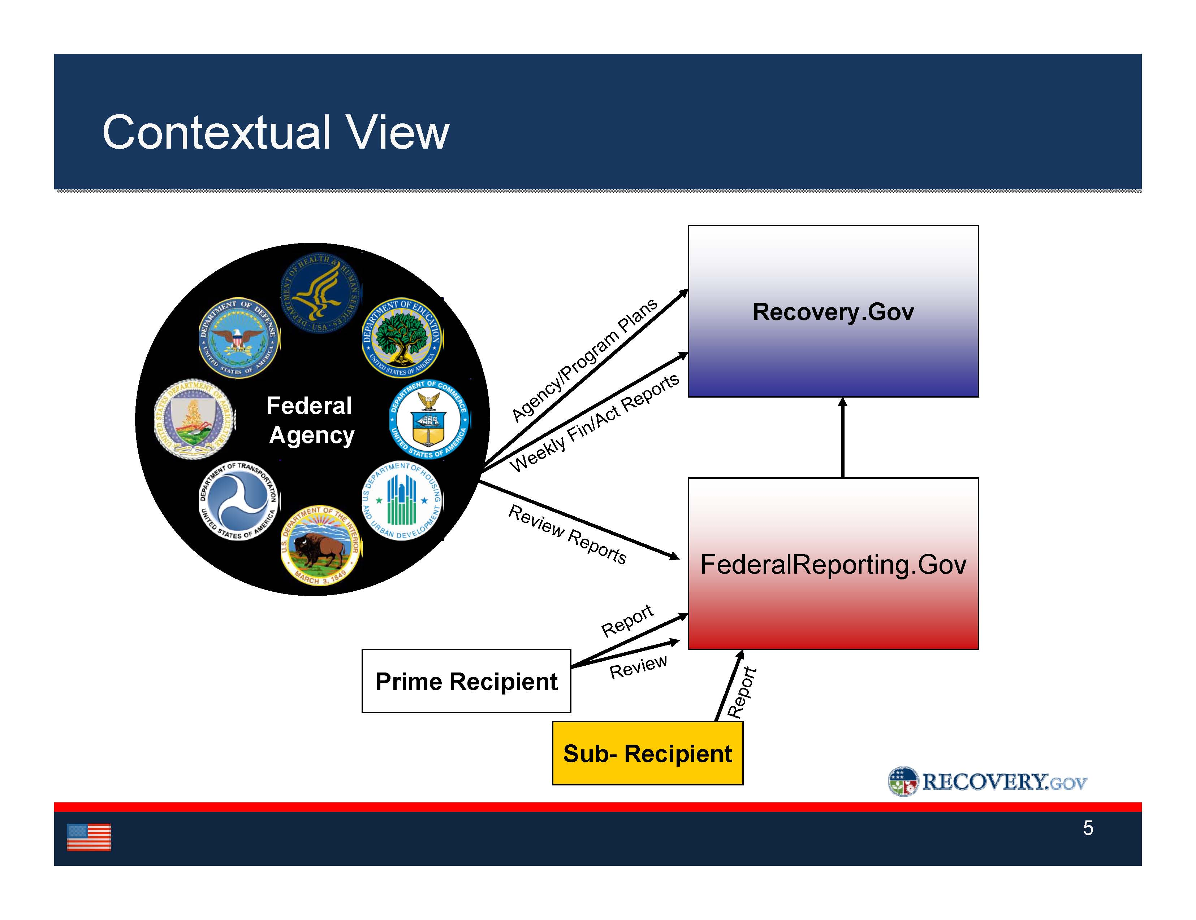

Slide 10
Required Reporting Data – Prime Recipient
Federal Funding Agency Name (SAM)
Award identification (SAM)
Prime Recipient D-U-N-S (SAM)
Recipient CCR information (SAM)
CFDA number, if applicable (SAM)
Recipient Congressional District (Auto)
Recipient account number (SAM)
Project/grant period (SAM)
Award type, date, description, and amount (SAM)
Amount of Federal Recovery Act funds expended to projects/activities (CGA)
Project description and status (SAM)
Activity code and description (PI or Designee)
Job creation/retention narrative and number (PI or Designee)
Infrastructure expenditures and rationale, if applicable (NA)
Recipient primary place of performance (Auto)
Recipient officer names and compensation – Top 5 (NA)
Total number and amount of small sub-awards; less than $25,000 (SAM)
Total number of sub-awards to individuals (SAM)
Total number of vendor payments less than $25,000 (Business &Finance/CGA)
Red = Static data elements

Slide 11
Principal Investigator’s Responsibilities
ARRA Compliance Expectations
  Funds should be spent in a timely fashion, i.e.,
  expeditiously and efficiently
  Cannot “supplant” existing funds with ARRA funds
  Compliance with special terms and conditions of sponsor
  Cost transfers between ARRA and non-ARRA funds will be
  monitored closely to ensure compliance with regulations
Notes:
ARRA accounts carry a unique identifier to assist tracking expenditures
ARRA Reporting Requirements are in addition to current sponsor reporting requirements
Additional data delegated by prime recipient reporting is required for sub-recipients and vendors

Slide 12
Principal Investigator’s Responsibilities
(cont’d)
  The PI must report on three data elements:
  Number of Jobs Created Retained
  Narrative of Job Description
  Activity Code
Remember, there are three requirements:
  Davis Bacon Wage Rate Requirements
  “Buy American” Mandate
  Minimize Fraud, Waste , and Abuse

Slide 13
Activity Code
NTEE Code
  NIH
    Major Category Titled – Health
    Subcategory: “H-Medical Research”
    NPC Code: “K – Research & Public Policy Analysis
  NSF
    Major Category Titled – Public and Societal Benefit
    Subcategories
      U – Science and Technology
      V – Social Science
    NPC Code: “K – Research & Public Policy Analysis

Slide 14
Jobs Created or Retained
Definitions
A job created is:
  A new position created and filled
  An existing unfilled position that is filled as a result of
  ARRA
A job retained is:
  an existing position that would not have been continued
  if not for ARRA
Notes:
Only compensated employment in the US should be counted
Created and Retained are combined and reported together. They are not separate fields
If an individual works on the funded project, and the associated personnel costs are charged to the ARRA award, this should be reported as job retained (or created if hired specifically to work on the project).

Slide 15
Jobs Created or Retained
A job cannot be counted as both created and retained
The reported number should include jobs created and
retained by sub-recipients and vendors
The number should be expressed as a “full-time equivalent” (FTE)
Notes:
SAM is collecting data from sub-recipients and may contact PI for verification in some cases.

Slide 16
Example
ARRA project requires :
1st quarter
One full-time ARRA funded position (post doc)
One full-time graduate student (.5 FTE)
One part-time technician (20 hours per week)
Principal Investigator (25% effort) = 2.25 FTE
3rd quarter:
One full-time ARRA funded position (post doc)
One full-time graduate student (.5 FTE)
Principal Investigator (25% effort) = 1.75 FTE
Notes:
For stable small scale projects this is unlikely to change much over the course of the project. Larger scale/long term projects may require more updating. It is “cumulative” reporting.
Discuss OMB model of ARRA time/money / totals

Slide 17
Description of Jobs Created
The narrative should include a brief description of the types of jobs created or retained.
This description may rely on job titles, broader labor categories, or the recipient’s existing practice, as long as the terms used are widely understood and describe the general nature of the work.
Notes:
Lab technician, graduate assistant, post-doctoral associate

Slide 18
Ramifications of Non-Compliance
(non-reporting or mismanagement of award)
  Termination of award(s)
  Return of funds to sponsor on an individual and institutional
  level
  Debarment from receiving future funds on an individual and
  institutional level
  Impairment to the USC’s reputation and credibility
  The Recovery Act’s transparency requirement will make the
  USC’s non-compliance visible to national/international
  constituents
  Inaccurate and uncorrected data will be made public on
  www.Recovery.gov
  If you have not submitted your report(s) on time, your award
  will be shut down

Slide 19
Important ARRA Resources
***USC ARRA Reporting Portal (Intranet) ***
https://image.admin.sc.edu/arra.php
USC Stimulus Response
http://www.sc.edu/research/stimulus/
NIH Grants Funded by the American Recovery and Reinvestment Act
http://grants.nih.gov/recovery/
NIH FAQs
http://grants.nih.gov/recovery/faqs_recovery.html
NIH ARRA Awards – Terms and Conditions
http://grants.nih.gov/grants/guide/notice-files/NOT-OD-09-080.html

Slide 20
Important ARRA Resources (cont’d)
NSF Information Related to the American Recovery and Reinvestment Act
http://www.nsf.gov/recovery/
NSF ARRA Terms and Conditions
http://www.nsf.gov/pubs/policydocs/arra/arratc_509.pdf
Recovery Act (main page)
http://www.whitehouse.gov/recovery/
OMB Guidance – Recovery Act
http://www.whitehouse.gov/omb/recovery_default/

Slide 21
Questions?
Related to ARRA Reporting System access or reporting:
Derlene Lowder
USC ARRA Reporting Coordinator
lowderd@mailbox.sc.edu
Phone: 803-777-6728
Related to specific federal agency awards:
Sponsored Awards Management
901 Sumter Street - 5th Floor, Byrnes Building
Columbia, SC 29208 Phone: 803-777-7093

